Slide 1
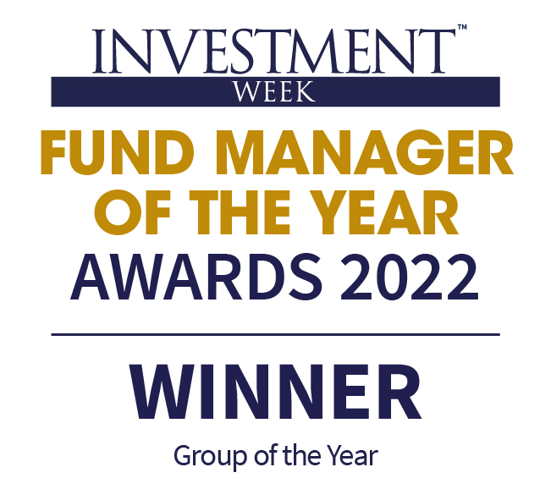
Five signals of change: How to navigate them to meet client objectives
For UK audience only
John Husselbee — Head of Multi-Asset James Klempster, CFA — Deputy Head of Multi-Asset
SimplyBiz | Winter 2024

Slide 2
Key risks
Past performance does not predict future returns. You may get back less than you originally invested.
The Funds and Model Portfolios managed by the Multi-Asset Team may be exposed to the following risks:
Credit Risk: There is a risk that an investment will fail to make required payments and this may reduce the income paid to the fund, or its capital value. The creditworthiness of a bond issuer may also affect that bond's value. Bonds that produce a higher level of income usually also carry greater risk as such bond issuers may have difficulty in paying their debts. The value of a bond would be significantly affected if the issuer either refused to pay or was unable to pay;
Counterparty Risk: The insolvency of any institutions providing services such as safekeeping of assets or acting as counterparty to derivatives or other instruments, may expose the Fund to financial loss;
Liquidity Risk: If underlying funds suspend or defer the payment of redemption proceeds, the Fund's ability to meet redemption requests may also be affected;
Interest Rate Risk: Fluctuations in interest rates may affect the value of the Fund and your investment. Bonds are affected by changes in interest rates and their value and the income they generate can rise or fall as a result;
Derivatives Risk: Some of the underlying funds may invest in derivatives, which can, in some circumstances, create wider fluctuations in their prices over time;
Emerging Markets: The Fund may invest in less economically developed markets (emerging markets) which can involve greater risks than well developed economies;
Currency Risk: The Fund invests in overseas markets and the value of the Fund may fall or rise as a result of changes in exchange rates.
Index Tracking Risk: The performance of any passive funds used may not exactly track that of their Indices.
Any performance shown in respect of the Model Portfolios are periodically restructured and/or rebalanced. Actual returns may vary from the model returns.
The risks detailed above are reflective of the full range of Funds managed by the Multi-Asset Team and not all of the risks listed are applicable to each individual Fund. For the risks associated with an individual Fund, please refer to its Key Investor Information Document (KIID)/PRIIP KID.
The issue of units/shares in the Liontrust Multi-Asset Funds may be subject to an initial charge, which will have an impact on the realisable value of the investment, particularly in the short term. Investments should always be considered as long term.
For the Multi-Asset Model Portfolios, any performance shown represents model portfolios which are periodically restructured and/or rebalanced. Actual returns may vary from the model returns. There is no certainty the investment objectives of the portfolio will actually be achieved, and no warranty or representation is given to this effect, whether express or implied. The portfolios therefore should be considered as long-term investments.

Slide 3
Learning objectives
Explain how recent market performance signpost challenges: the rise of AI and mega caps and passives in a low growth, more volatile world in which globalisation is fragmenting
Identify ways active management and diversified investment approaches can aid clients in achieving their long-term investment objectives
Explain how a partnership orientated approach to investment and client management complements the ongoing requirements of Consumer Duty

Slide 4
What’s going on?
1
2
3
Inflation down
Employment robust
Economic growth solid
Source: Liontrust, May 2023. For illustrative purposes only

Slide 5
US Index concentration
Source: Morningstar, Bloomberg, 31.07.24

Slide 7
The five signals
Signal 1
Signal 2
Signal 3
Signal 4
Signal 5
FRAGMENTATION
VOLATILITY
CONCENTRATION
PASSIVES
CLIENTS

Slide 8
Signal 1: Fragmentation of globalisation Power blocs, tariffs, the rise of populist parties in Europe, US Presidential election in November and major conflicts in Europe and the Middle East

Slide 9
“More and more of our imports come from overseas” George W Bush
US International Trade Deficit
NAFTA took effect from Jan 1994
Trump’s tariffs began Jan 2018
Source: US Bureau of Economic Analysis, Bloomberg 31.07.2024. BEA data pre 1992 estimated

Slide 10
The canary in the goldmine?
10-year gold reserve change (USD value)
The new gold rush reflects the world’s deep worries
– Financial Times, 23 Aug 2024
Source: International Monetary Fund, International Financial Statistics, August 2024

Slide 11
Fragmentation of Globalisation – so what?
THEN – Loose living
NOW – Tense times
Globally integrated | Multi-polar
Low inflation | Higher inflation
Low cost of capital | No more easy money
What is changing?
THEN – Peak globalisation
NOW – De-globalising
Secular deflation | Secular inflation
So what?
What you need?
Actively
Different
Actively
Different
Discipline
Diversification
Dynamic

Slide 12
Signal 2: Meeting client objectives in higher volatility environment Over a third of advisers said they’d adjusted financial plans for clients last year because of demands on their money
Source: Lang Cat’s State of the Nation report, over a third of advisers said they’d adjusted financial plans for one in 10 clients last year because of market performance and demands on their money

Slide 13
Volatility has increased but is not at crisis levels
Intraday
spike
65.7
5th Aug 2024
‘Fear gauge’ surges to highest level since early stages of pandemic
– Financial Times, 05 Aug 2024
Really?
Source: Bloomberg, August 2024

Slide 14
Markets don’t go up in a straight line
Past performance does not predict future returns
US stocks tumble at open as global sell-off gathers pace
– Financial Times, 05 Aug 2024
US stocks end a rollercoaster week back where they started
– Financial Times, 09 Aug 2024
“Whatever it takes” world
Source: Bloomberg, 01.01.1986 to 27.08.24

Slide 15
The antidote to volatility
Past performance does not predict future returns
Value of £10,000 invested in the FTSE All Share Jan 1986 – July 2023
When were the 10 best days in the market?
+9.2%
24 Nov 2008
+8.9%
24 Mar 2020
+8.5%
19 Sept 2008
+7.7%
29 Oct 2008
+7.5%
13 Oct 2008
+5.9%
10 Apr 1992
+5.7%
21 Oct 1987
+5.3%
08 Dec 2008
+5.2%
13 Mar 2003
+5.2%
10 May 2010
Source: Morningstar, 01.01.1986 to 31.07.23

Slide 16
Higher Volatility – so what?
THEN – Loose living
NOW – Tense times
Globally integrated | Multi-polar
Low inflation | Higher inflation
Low cost of capital | No more easy money
What is changing?
THEN – Simple success
NOW – Diversification, decisions
“Whatever it takes” world | Stay the course
So what?
What you need?
Actively
Different
Actively
Different
Discipline
Diversification
Dynamic

Slide 17
Signal 3: Dominance of AI and mega caps The top 10 S&P 500 companies account for 36% of the index value but only 27% of the revenue
Source: Bloomberg as at 02.10.24

Slide 18
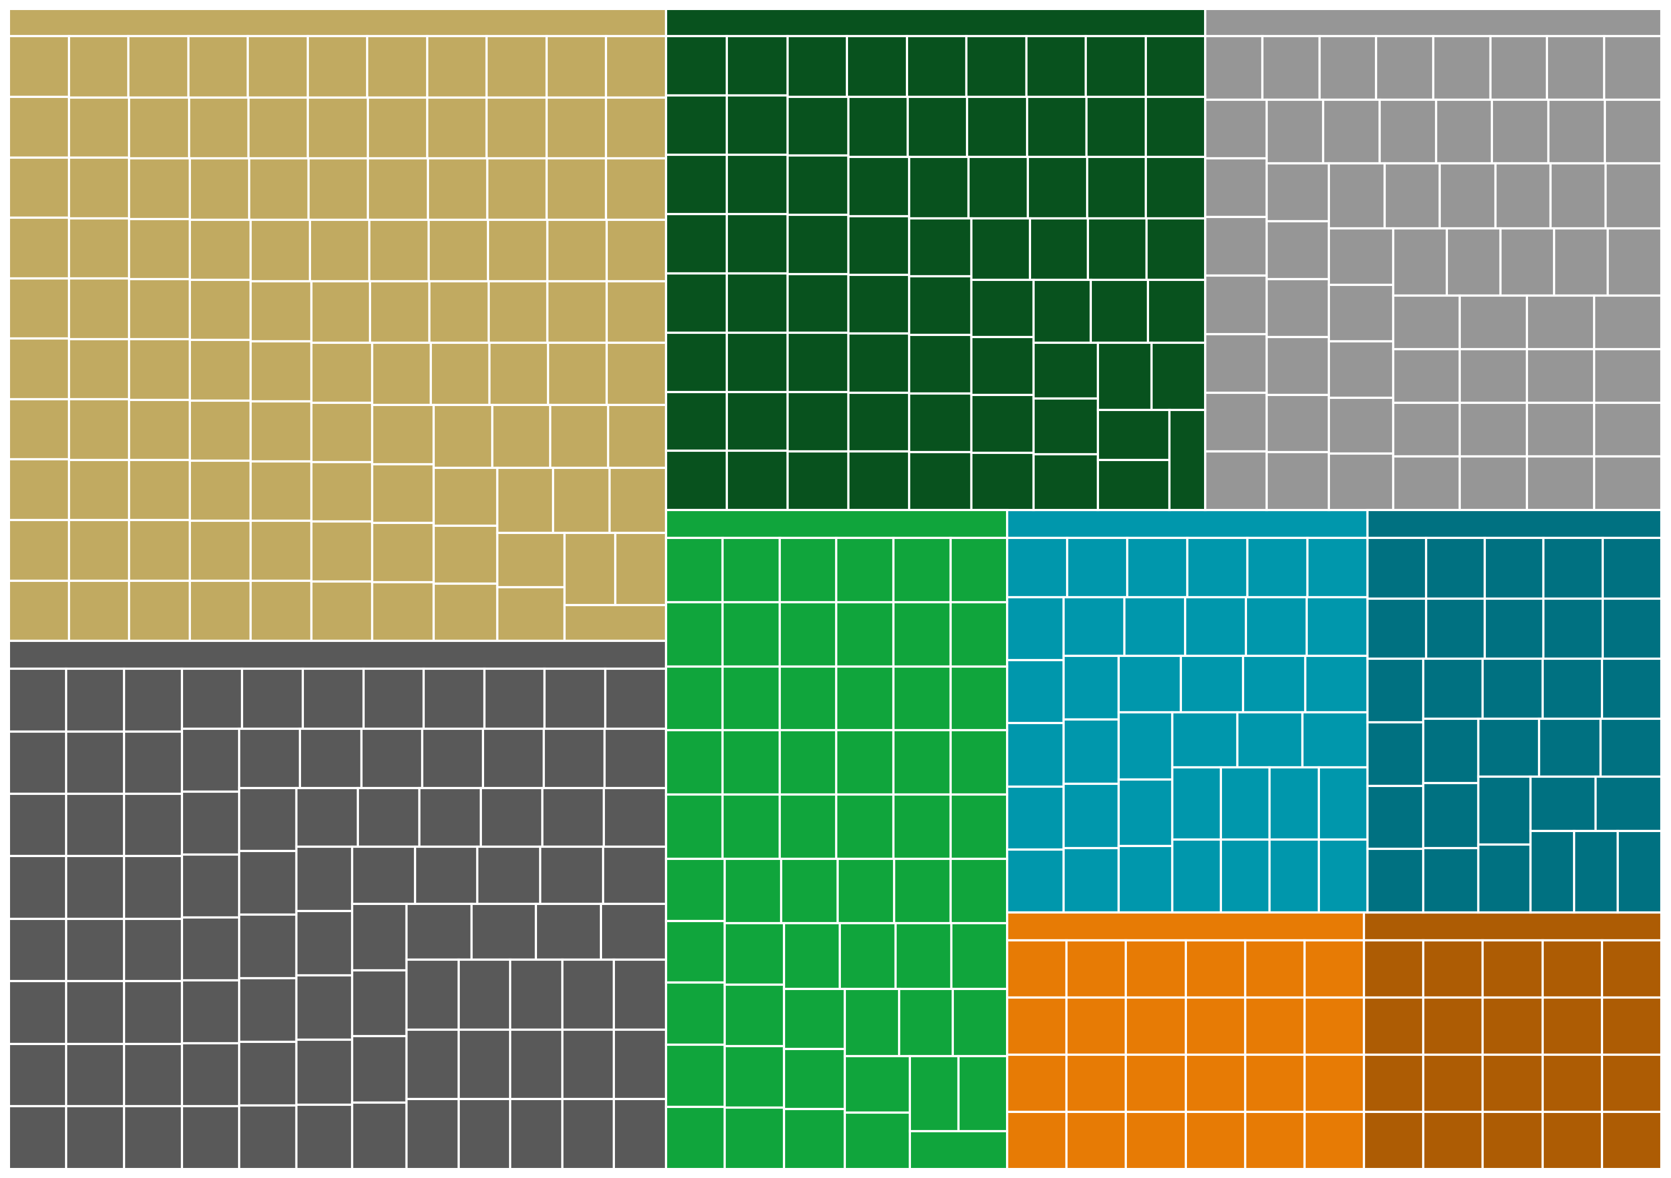
Market cap weighted indices have substantial biases
S&P Sector Breakdown – Equally weighted
1
2
3
4
5
6
7
7
1
2
6
4
5
3
Technology
Consumer, Non-cyclical
Financial
Communications
Consumer, Cyclical
Industrial
Energy
Utilities
Basic Materials
Source: Bloomberg 31.07.24. *Representation of the ‘Magnificent 7’. For illustrative purposes. All use of company logos or trademarks in this presentation are for reference purposes only

Slide 19
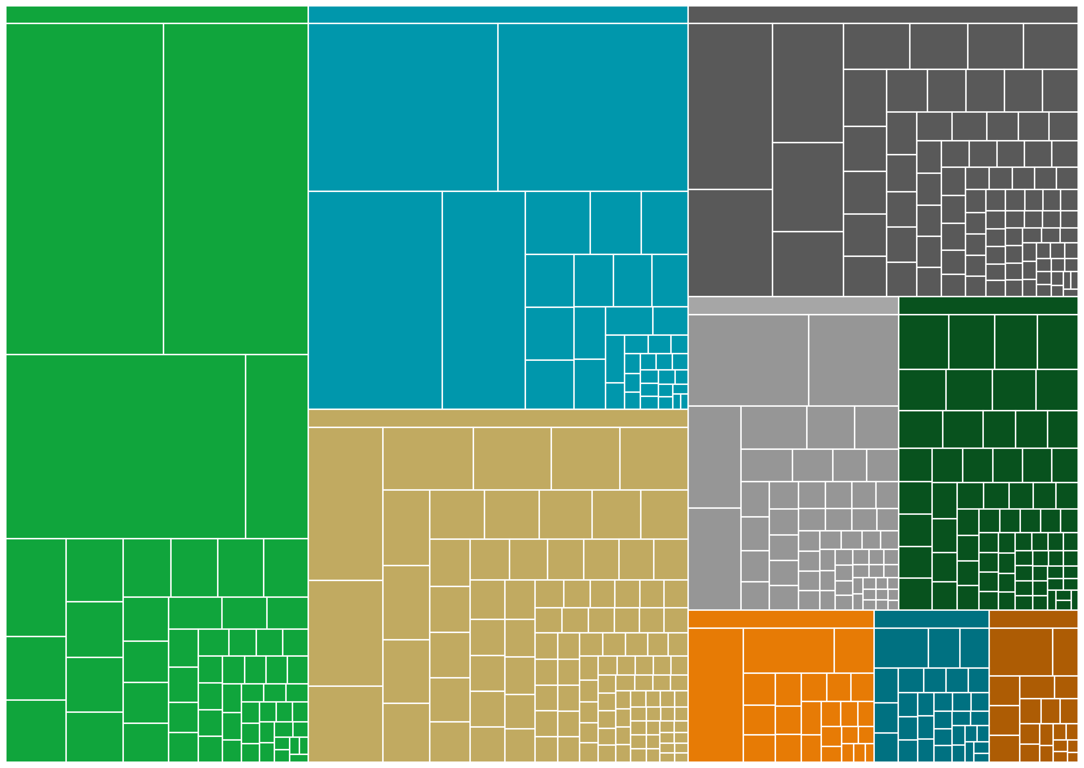
Market cap weighted indices have substantial biases
S&P Sector Breakdown – Market cap weighted
S&P Sector Breakdown – Equally weighted
1
2
4
5
6
7
7
3
1
2
6
4
5
3
Technology
Consumer, Non-cyclical
Financial
Communications
Consumer, Cyclical
Industrial
Energy
Utilities
Basic Materials
Source: Bloomberg 31.07.24. *Representation of the ‘Magnificent 7’. For illustrative purposes. All use of company logos or trademarks in this presentation are for reference purposes only

Slide 20
Bursting Bubbles bring profound pain
Past performance does not predict future returns
MSCI World Technology peak on
27 March 2000
If you bought at its peak,
it took nearly 18 years to breakeven.
If you bought 1 year before the bubble burst, it took nearly 15 years to breakeven.
If you bought 5 years before the bubble burst, you would have stayed in profit throughout.
MSCI World IT Index
Peak 2000
1 year before
5 years before
Source: Bloomberg, 22.08.24

Slide 21
Mega cap dominance – so what?
THEN – Loose living
NOW – Tense times
Globally integrated | Multi-polar
Low inflation | Higher inflation
Low cost of capital | No more easy money
What is changing?
THEN – Simple success
NOW – Diversification, decisions
Concentrated, expensive, large cap | Value rotation, smaller companies
So what?
What you need?
Actively
Different
Actively
Different
Discipline
Diversification
Dynamic

Slide 22
Signal 4: The rise of passives The % of assets in passive investments within Discretionary MPS has risen from 29% to 43% over the past two years. 39% of advisers’ client assets are being invested passively compared to 26% in the 2nd quarter of 2021*
*Source: RiF, 2021

Slide 23
Available and suitable
AVAILABILITY | SUITABILITY | BLENDING
 | Fund structure UT/OEIC or ETF | Cross sectional volatility
 | Tracking error | % of stocks outperforming index
 | Replication methodology | Index concentration
 | Tax / domicile, Dilution policy, Securities lending
 | Benchmark relevance, breadth, calculation
 | Investment experience, team size
 | Fees
Source: Liontrust, Morningstar, PWL Capital, data as at 30.09.24

Slide 24
Price is what you pay, value is what you get
Past performance does not predict future returns
FTSE
All-Share
6.28%
FTSE 250
6.21%
Passive Funds
Active Funds
Source: Liontrust, Morningstar as at 31.07.24, GBP
Notes:
Paying more not a bad thing as can get some o/p over the long run
Greater variability of outcomes – not a bad just need to have skill and patience

Slide 25
The rise of Passives – so what?
THEN – Loose living
NOW – Tense times
Globally integrated | Multi-polar
Low inflation | Higher inflation
Low cost of capital | No more easy money
What is changing?
THEN – Simple success
NOW – Diversification, decisions
Momentum | Active opportunity
So what?
What you need?
Actively
Different
Actively
Different
Discipline
Diversification
Dynamic

Slide 26
Conclusion – Navigating the new world
Signal
Actively Different
Fragmentation | Review SAA
Volatile | Stay the course
Valuation | Rotation
Momentum | Review Active / Passive blends
What you need?
Actively
Different
Actively
Different
Discipline
Diversification
Dynamic

Slide 27
Actively Different
Liontrust MA Intermediate Strategy
Passive Provider
Source: Morningstar, Beta relative to MSCI World LCL, data as at 31.07.24

Slide 28
Signal 5: Ongoing compliance with Consumer Duty “Consumer Duty is an evolutionary journey of continuous improvement and not a once and done” – Sheldon Mills, Executive Director of Consumers and Competition at the FCA
Notes:
For consumer support, advisers state they would like information from asset managers on the following:
Different market cycles
Illustrations of ‘time in the market’
How asset classes behave across market cycles
Asset classes and asset allocation’s contribution to diversification
Educational materials
Timely digital updates that can be shared with clients
Regular, pro-active updates on activity (fund and Consumer Duty related)

Slide 29
What’s next?
Expected work for Q4 2024
1
Review of firms’ treatment of consumers in vulnerable circumstances
2
Additional work on embedding fair value requirements
3
Sharing good and poor practice
Sources: 1: https://www.fca.org.uk/news/news-stories/review-firms-treatment-customers-vulnerable-circumstances
2 & 3: https://www.fca.org.uk/news/speeches/taking-leap-consumer-duty. All use of company logos or trademarks in this presentation are for reference purposes only

Slide 30
Consumer duty – What have you changed?
Source: Lang Cat state of the advice nation, 2024

Slide 31
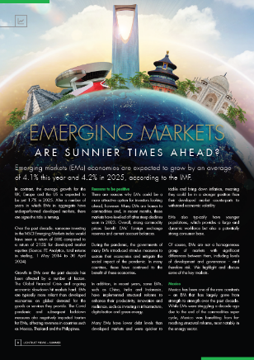
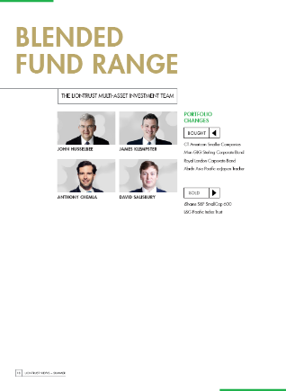
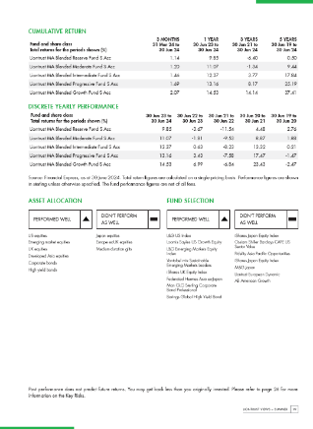
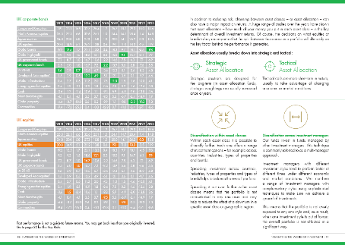
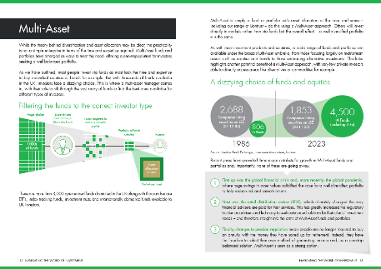
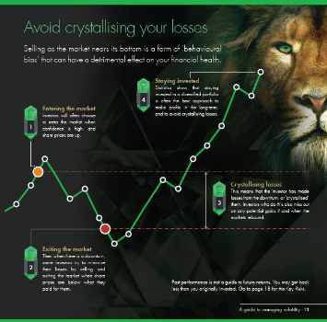
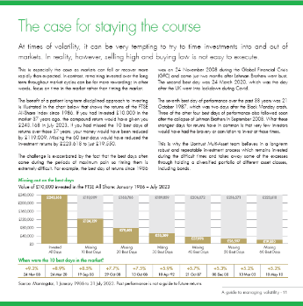
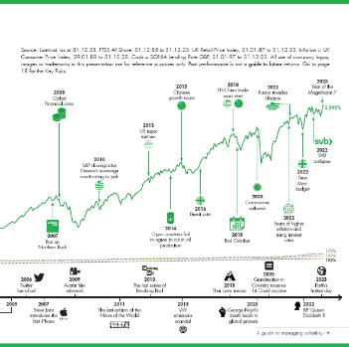
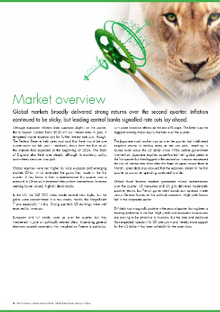
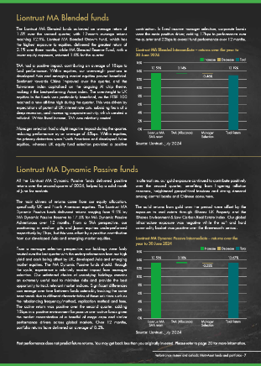
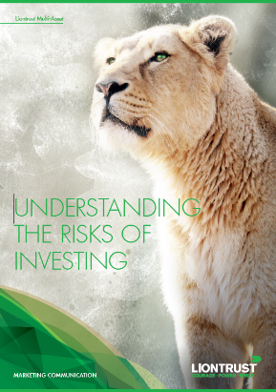
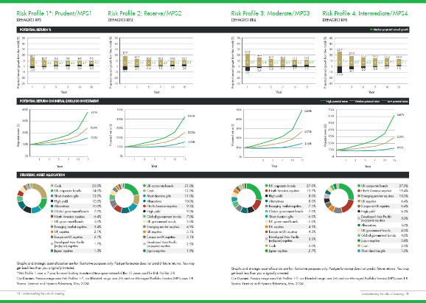
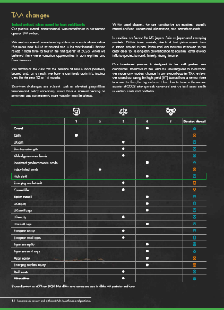
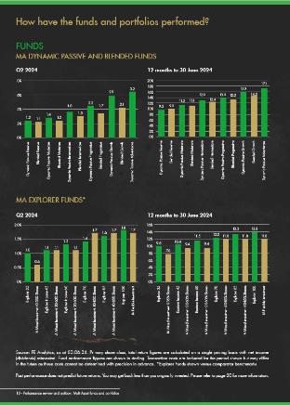
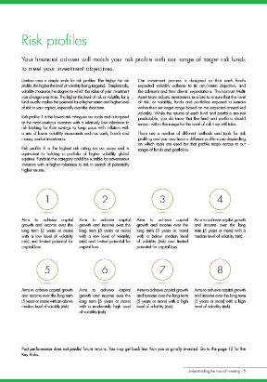
Actively Different advisor support – Client facing literature
Market leading literature – Helping advisers meet consumer duty requirements
Managing Volatility scores highly with consumers for usefulness, clarity, accessibility and engagement

Slide 32
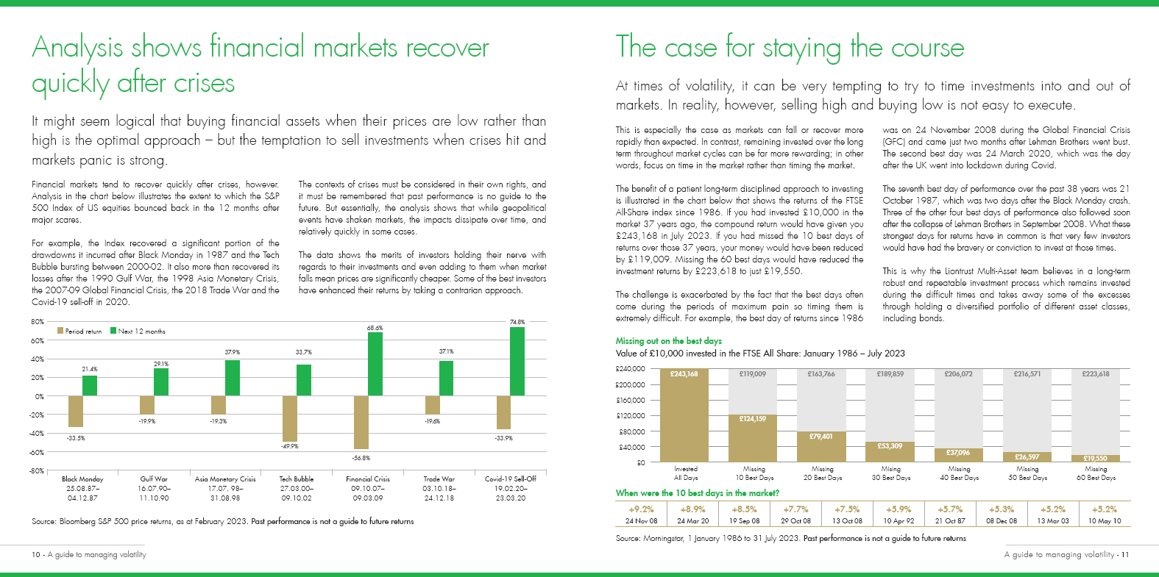
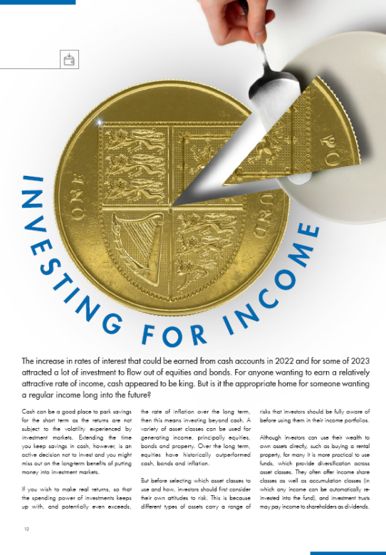
The Co-Branding opportunities

Slide 33
Learning outcomes
Explain how recent market performance signpost challenges: the rise of AI and mega caps and passives in a low growth, more volatile world in which globalisation is fragmenting
Identify ways active management and diversified investment approaches can aid clients in achieving their long-term investment objectives
Explain how a partnership orientated approach to investment and client management complements the ongoing requirements of Consumer Duty

Slide 34
The seven other investment teams at Liontrust
Cashflow Solution
Global Innovation
European ex UK Equity
European Equity
Long/Short
Global Equities
James Inglis-Jones Co-Head of
Cashflow Solution
Samantha Gleave Co-Head of
Cashflow Solution
Storm Uru Head of Global
Innovation
Economic Advantage
Global Equities
Sustainable Investment
UK Equity
Global Equities
Mixed Asset
US Equities
Indian Equities
LATAM Equities
Japan Equities
China Equities
Russian Equities
UK Equities
Fixed Income
SF Mixed Asset
European Equities
Global Equities
US Equity
Anthony Cross Head of Economic
Advantage
Mark Hawtin Head of Global
Equities
Peter Michaelis Head of Sustainable
Investment
Global Fixed Income
Global Fundamental
Fixed Income
UK Equity
Investment Trust
Phil Milburn Co-Head of Global
Fixed Income
Donald Phillips Co-Head of Global
Fixed Income
Imran Sattar Head of Global
Fundamental

Slide 35
Liontrust Multi Asset investment management team
Multi-Asset investment team
Multi-Asset funds and portfolios
Multi-Asset investment support
John Husselbee Head of
Liontrust Multi-Asset
39 years Industry experience
Running MPS Since 1985
James Klempster Deputy Head of Liontrust Multi-Asset
20 years Industry experience
Running MPS Since 2007
Adrian Holmes Head of Multi-Asset Investment Support
28 years Industry experience
John Houghton Investment Support Senior Executive
19 years Industry experience
Samuel Norton Investment Support Executive
2 years Industry experience
Liontrust has created one of the most experienced and highly regarded multi-asset multi-manager teams in the UK retail market led by John Husselbee with £4.1 billion assets under management and advice*
Anthony Chemla Fund Manager
18 years Industry experience
Running MPS Since 2016
David Salisbury Fund Analyst
6 years Industry experience
Running MPS Since 2022
Source: Liontrust, as at October 2024. *As at 30.09.24

Slide 36
Actively Different
Actively managed
Adviser support
Value for money
Actively manage every stage of the process
SAA
TAA
Unfettered fund selection
Portfolio construction
Long term, patient investors
Broad diversification
External partnerships across SAA and TAA
Tailored adviser support
Fund manager access
Market leading literature
Educational content
White label
Digital tools and services
Reporting to support advisers with consumer duty
Competitive OCF
Benefit of resources from across Liontrust including seven other investment teams
What you need?
Actively
Different
Actively
Different
Discipline
Diversification
Dynamic

Slide 37
Liontrust Multi-Asset Ranges
Multi-Asset Funds
Multi-Asset Portfolios
Fund range | OCF (%) | Risk Profiled (risk bands) | Risk Profile Range
Liontrust Multi-Asset Dynamic Passive Funds | 0.38 – 0.42 | Defaqto | 1 – 7
Liontrust Multi-Asset Blended Funds | 0.66 – 0.82 |  | 2 – 6
Portfolio range | DFM Fee* | Total Inc. underlying fund charge | Risk Profiled (risk bands) | Risk Profile Range
Liontrust Multi-Asset MPS Dynamic Passive Portfolios | 0.15 | 0.34 – 0.38 | Defaqto | 1 – 8
Liontrust Multi-Asset MPS Blended Growth Portfolios | 0.20 | 0.51 – 0.68 |  | 1 – 8
Source: Liontrust, as at 30.06.24 *Partnership fees

Slide 38
Liontrust MA Dynamic Passive Fund range
Past performance does not predict future returns
5-year performance
Source: FE Analytics, 30.09.19 to 30.09.24. Total return figures are calculated on a single pricing basis with net income (dividends) reinvested. Performance figures are shown in sterling. Transaction costs are included for the period shown but may differ in the future as these costs cannot be determined with precision in advance
You may get back less than you originally invested. Please refer to the Key Risks slide for more information

Slide 39
Liontrust MA Dynamic Passive Intermediate Fund
Past performance does not predict future returns
5-year performance
Change in SAA
New MA proposition implemented here’
Source: FE Analytics, 30.09.19 to 30.09.24. Liontrust MA Dynamic Passive Intermediate Fund, net of fees, income reinvested basis, total return, S Acc share class
You may get back less than you originally invested. Please refer to the Key Risks slide for more information

Slide 40
Liontrust MA Dynamic Passive Intermediate Fund
Past performance does not predict future returns
Performance since new SAA (28.02.2023)
Source: FE Analytics, 28.02.23 to 30.09.24. Liontrust MA Dynamic Passive Intermediate Fund, net of fees, income reinvested basis, total return, S Acc share class
You may get back less than you originally invested. Please refer to the Key Risks slide for more information

Slide 41
Distribution capabilities – Face-to-face
UK Distribution
Strategic Partnership Sales team
Kristian Cook Head of UK Distribution
Sophie Andrews Head of Strategic Partners
& Consolidators
Jamie Stafford Strategic Partners & Consolidators
Relationship Manager
Jemima Kenworthy UK Client Service
Midlands and the North
Regional Sales Team
2
1
3
1
1
4
5
6
2
Mark Wright Head of Regional Sales Midlands
Graeme Southern North, Scotland and Northern Ireland
Andrew Taylor North, Scotland and Channel Islands
Kiran Alonso East
Jonny Harbottle South West and Wales
Kyle Barwell South East
3
4
Regional Sales Executives
5
Rebecca Conafray Head of Sales Executive Team
South East
Anthony Drennan Regional Sales Executive
South West
Jack Morris Regional Sales Executive
Midlands & North
Tom Howell Regional Sales Executive
East
6
UK Client services
Vanessa Lawley Head of UK Client Service
Hana Nawazish Sales Event Manager
& Sales Support
Catherine Smith UK Client Service
& Platform Manager
Sagar Mehta UK Client Service
London
Bella Hill-Baker UK Client Service
South
Source: Liontrust, July 2024

Slide 42
Liontrust MA Dynamic Passive Fund range
Past performance does not predict future returns
Discrete performance
To previous quarter 12 months ending (%) | Sep-24 | Sep-23 | Sep-22 | Sep-21 | Sep-20
Liontrust MA Dynamic Passive Reserve Fund S Acc | 11.9 | 1.8 | -14.2 | 4.8 | 0.7
Liontrust MA Dynamic Passive Moderate Fund S Acc | 13.3 | 2.8 | -12.5 | 7.6 | -0.1
Liontrust MA Dynamic Passive Intermediate Fund S Acc | 14.7 | 4.0 | -9.8 | 11.5 | -0.8
Liontrust MA Dynamic Passive Progressive Fund S Acc | 15.6 | 5.0 | -7.2 | 16.0 | -2.5
Liontrust MA Dynamic Passive Growth Fund S Acc | 17.4 | 6.8 | -4.9 | 21.5 | -3.8
Liontrust MA Dynamic Passive Adventurous Fund S Acc | 18.4 | 6.4 | -4.7 | 22.6 | -0.9
Source: FE Analytics as at 30.09.24. Total return figures are calculated on a single pricing basis with net income (dividends) reinvested. Performance figures are shown in sterling. Transaction costs are included for the period shown but may differ in the future as these costs cannot be determined with precision in advance
You may get back less than you originally invested. Please refer to the Key Risks slide for more information

Slide 43
Disclaimer
For investment professionals only
This presentation is issued by Liontrust Investment Partners LLP (2 Savoy Court, London WC2R 0EZ), authorised and regulated in the UK by the Financial Conduct Authority (FRN 518552) to undertake regulated investment business in respect of content related to the Liontrust Multi-Asset Model Portfolios.
It should not be construed as advice for investment in any product or security mentioned, an offer to buy or sell investments mentioned, or a solicitation to purchase securities in any company or investment product. Examples of stocks and funds are provided for general information only to demonstrate our investment philosophy. The investment being promoted is for units in a fund, not directly in the underlying assets.
The document contains information and analysis that is believed to be accurate at the time of publication, but is subject to change without notice. Whilst care has been taken in compiling the content of this document, no representation or warranty, whether express or implied, is made by Liontrust as to its accuracy or completeness, including for external sources (which may have been used) which have not been verified.
All the information provided should be treated as confidential, information may constitute material non-public information, the disclosure of which may be prohibited by law, and the legal responsibility for its use is borne solely by the recipient. This information should not be copied, forwarded, reproduced, divulged or otherwise distributed in any form whether by way of fax, email, oral or otherwise, in whole or in part without the express and prior written consent of Liontrust.
This is a marketing communication. Before making an investment decision, you should familiarise yourself with the different types of specific risks associated with the investment portfolio of each of our Funds and Multi-Asset Model Portfolios. For Liontrust Funds, this information can be found in the final Prospectus and Key Investor Information Documents (KIIDs) and/or PRIIP/KID available on our website: www.liontrust.co.uk. Our Multi-Asset Model Portfolios are available exclusively through financial advisers. Financial advisers can find further information on the different types of specific risk associated with the Liontrust Multi-Asset Model Portfolios in the relevant brochure, also available on our website: www.liontrust.co.uk. If you are not a professional investor please consult a regulated financial adviser regarding the suitability of such an investment for you and your personal circumstances.
PJ | COMP 30.09.24
PJ | TEA/28.10.24

